Slide 1
Cross-platform development with Xamarin Oleksandr Krakovetskyi CEO, DevRain Solutions @sashaeve, alex.krakovetskiy@devrain.com

Slide 2
About
CEO of DevRain Solutions – software development.
Microsoft Regional Director.
Microsoft Windows Phone Most Valuable Professional (Artificial Intelligence).
Best Professional in Software Architecture (Ukrainian IT Award).
Ph.D. in Computer Science.
Speaker and blogger.

Slide 3

Universal Windows Platform
Windows Platform
Web Platform
Universal Windows 8 Apps (C++/C#/JS)
Microsoft Edge HTML Engine
Universal Windows 10 Apps (C++/C#/JS)
Surface Hub
Desktop
Cordova Tooling (HTML/JS)
Project Centennial (Classic Apps)
Hosted Web Apps (HTML/JS)
Universal Windows Platform
IoT
Xbox
Middleware Platforms
Other Mobile Platforms
Middleware Partners (e.g., Xamarin)
Holographic
Mobile
Project Astoria (Java/C++)
Game Engine Partners (e.g., Unity)
Project Islandwood (Objective C/C++)

Slide 4
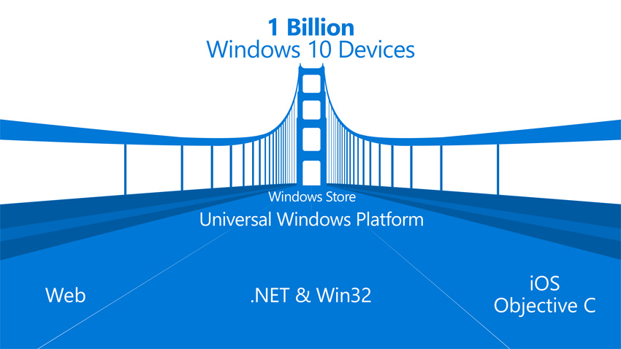
Windows Bridges
Desktop Bridge (Project Centennial)
Hosted Web Apps (”Project Westminster”)
Mobilize.Net’s Silverlight Bridge
Windows Bridge for iOS (“Project Islandwood”)
Windows Bridge for Android (”Project Astoria”)
https://developer.microsoft.com/en-us/windows/bridges

Slide 5
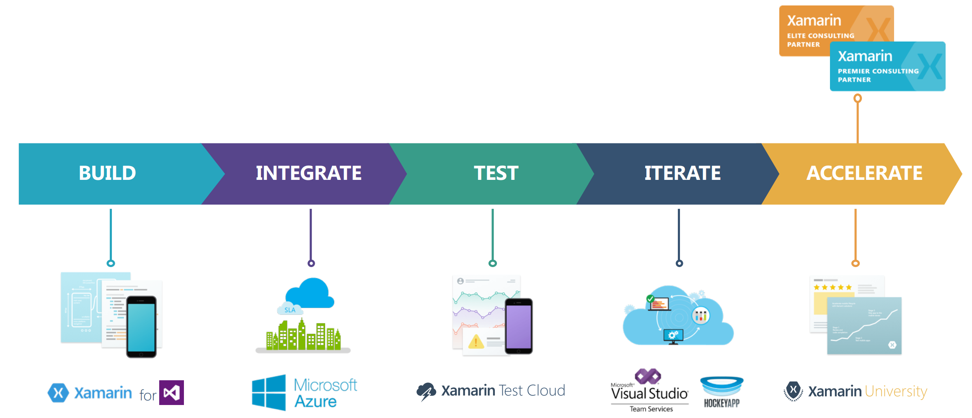
Complete Mobile Ecosystem

Slide 6
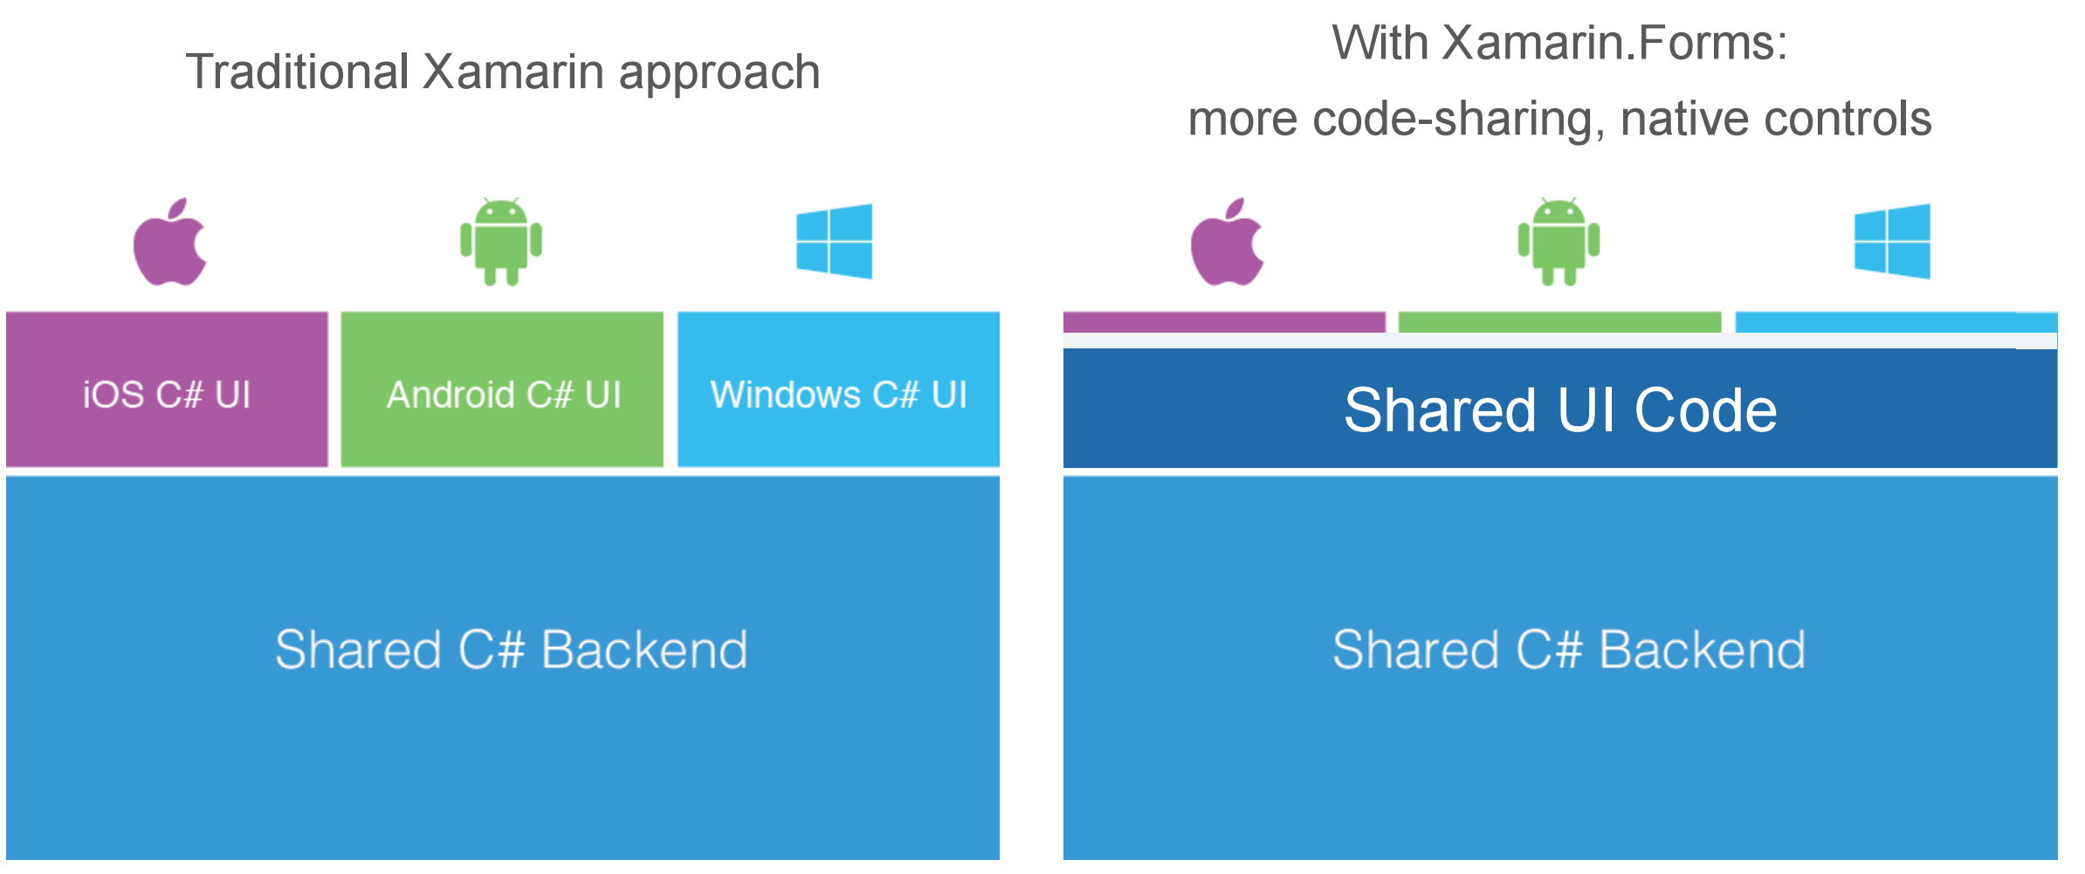
Code Sharing Architectural Approaches

Slide 7
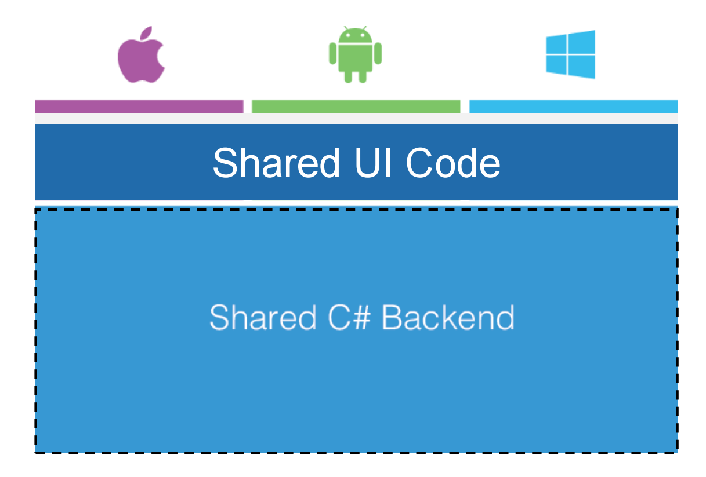
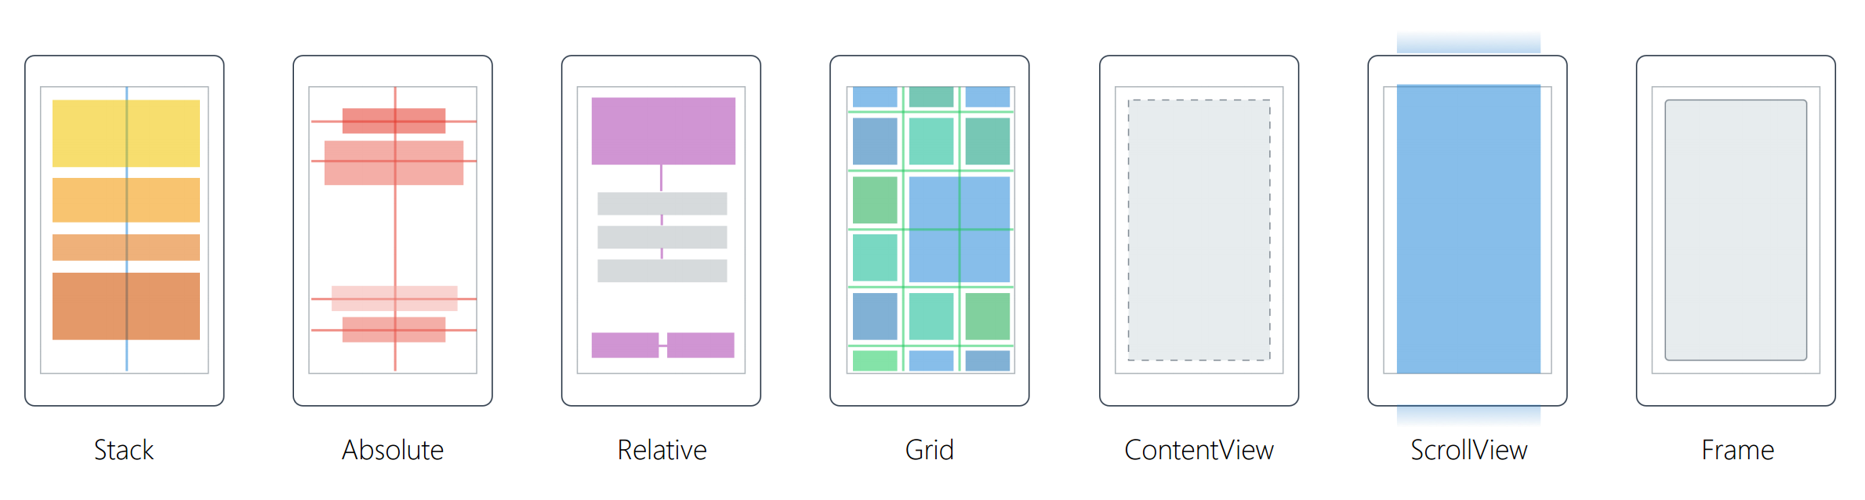
Xamarin.Forms
40+ Pages, Layouts, and Controls
Build from code behind or XAML
Two-way Data Binding
Navigation
Animation API
Dependency Service
Messaging Center

Slide 8
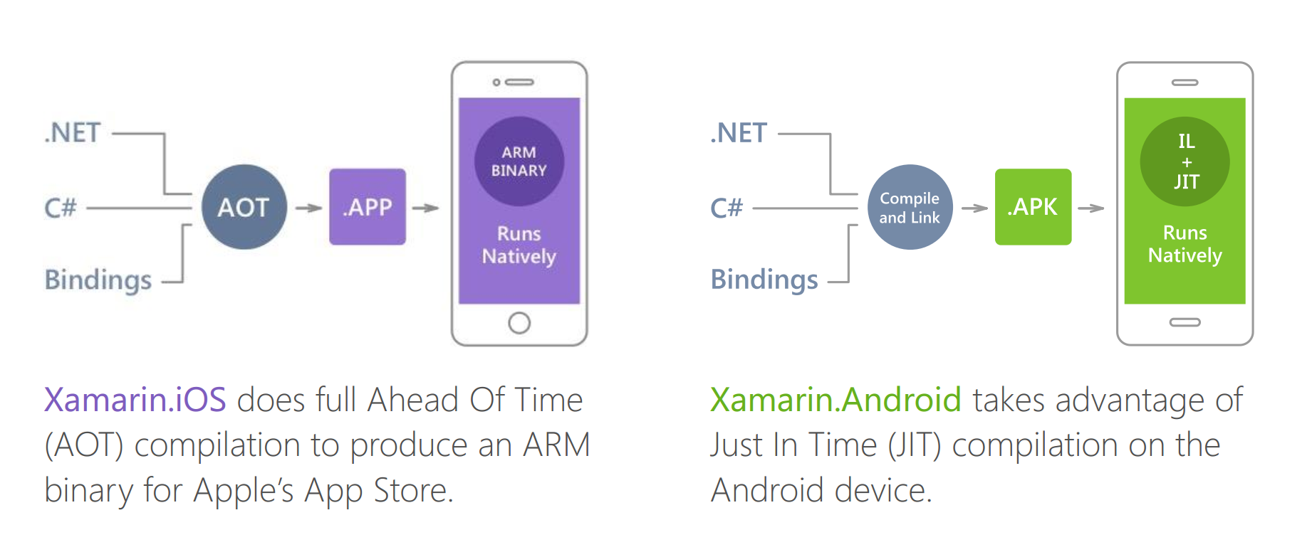
Native Performance

Slide 9
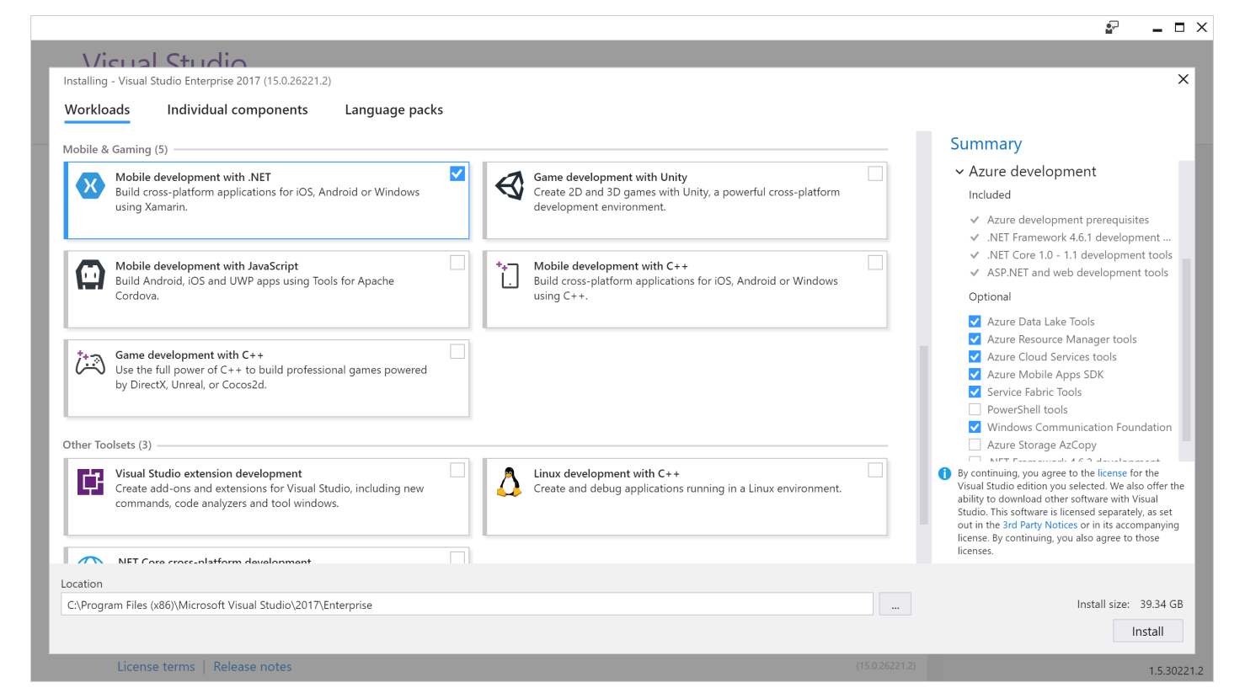
Xamarin for Visual Studio

Slide 10
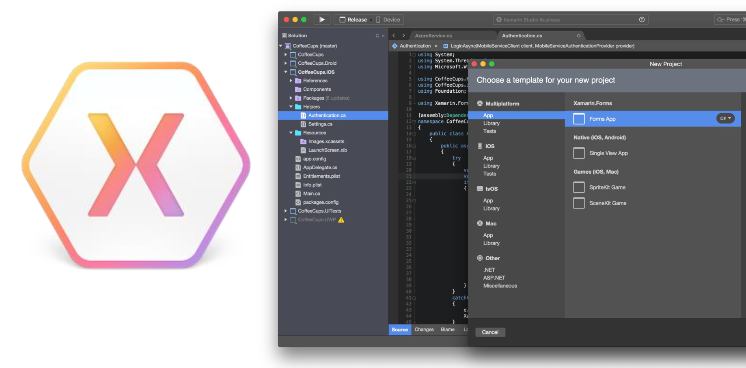
Xamarin Studio - Mac

Slide 11
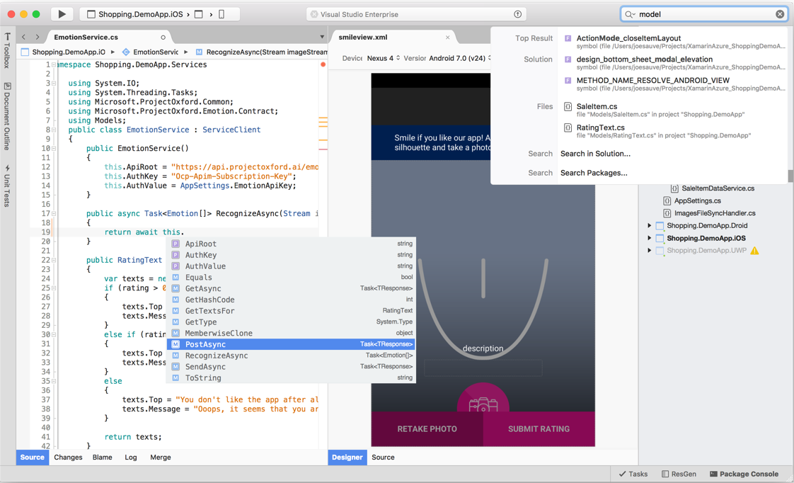
Visual Studio for Mac
iOS/Android/Mac OS
.NET Development
.NET Core & ASP.NET Core
Tools for Azure
https://www.visualstudio.com/vs/visual-studio-mac/

Slide 12
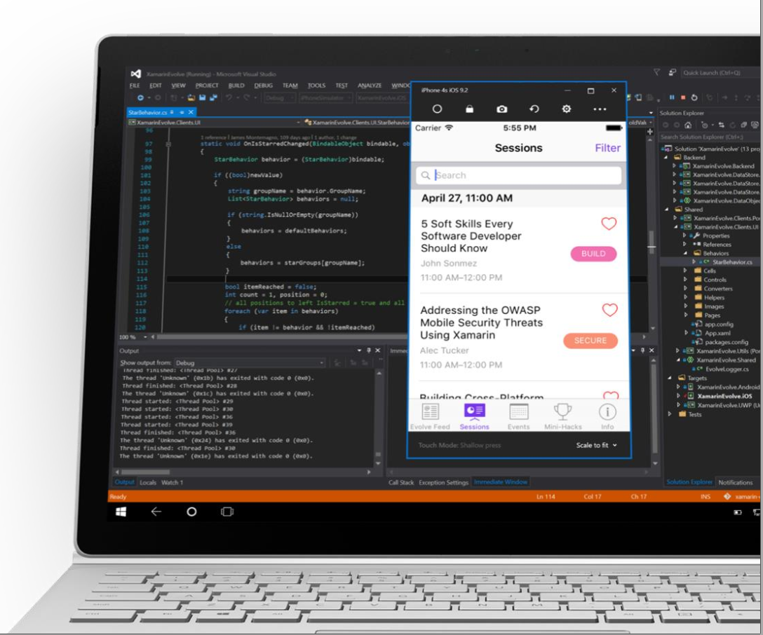
Visual Studio iOS Simulator Remoting
Multi-Touch Enabled
Pressure Sensitive
Rotate, screenshots, location changes
Never leave VS
* Requires Visual Studio Enterprise

Slide 13
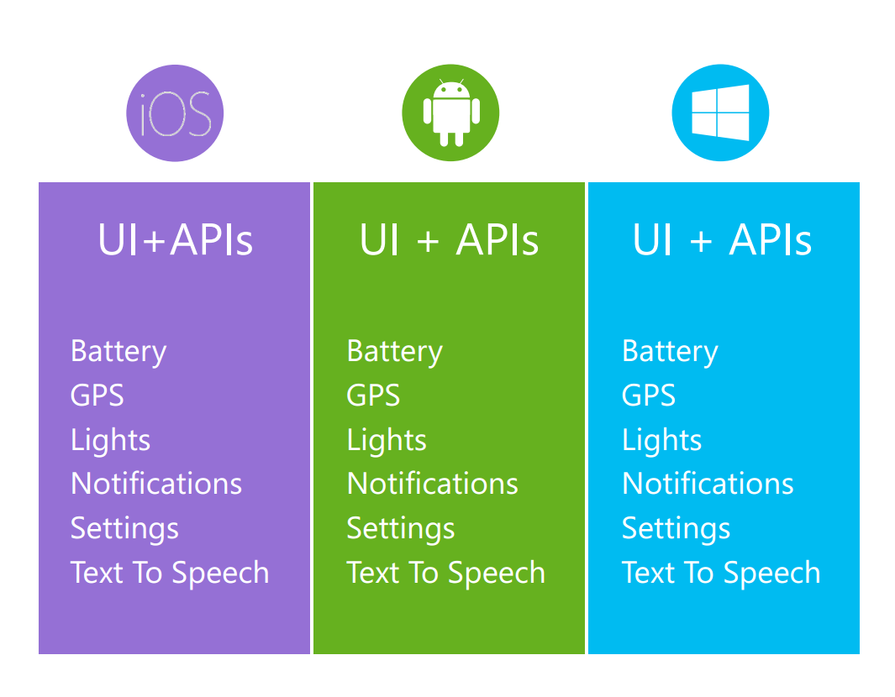
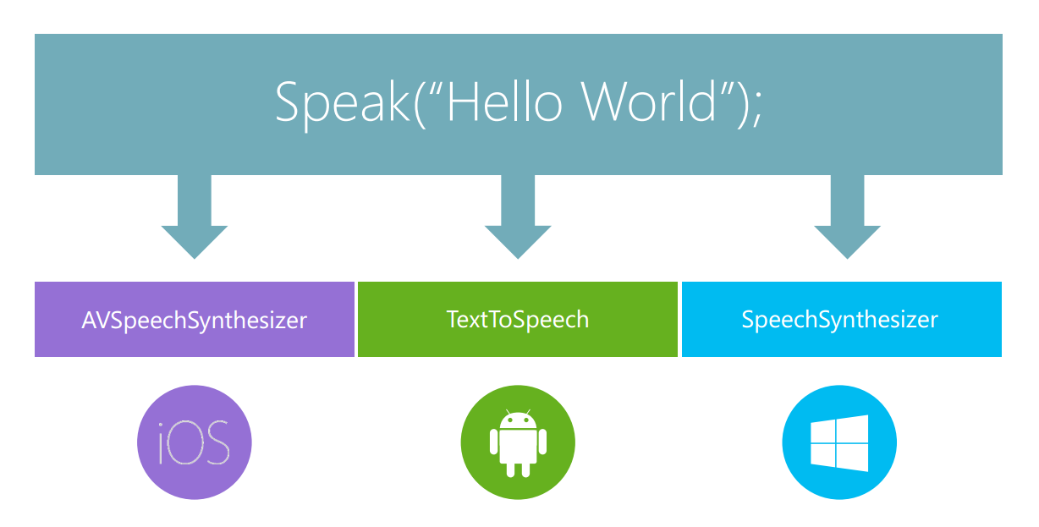
Platform Specific Code

Slide 14

Plugins for Xamarin
github.com/xamarin/plugins

Slide 15
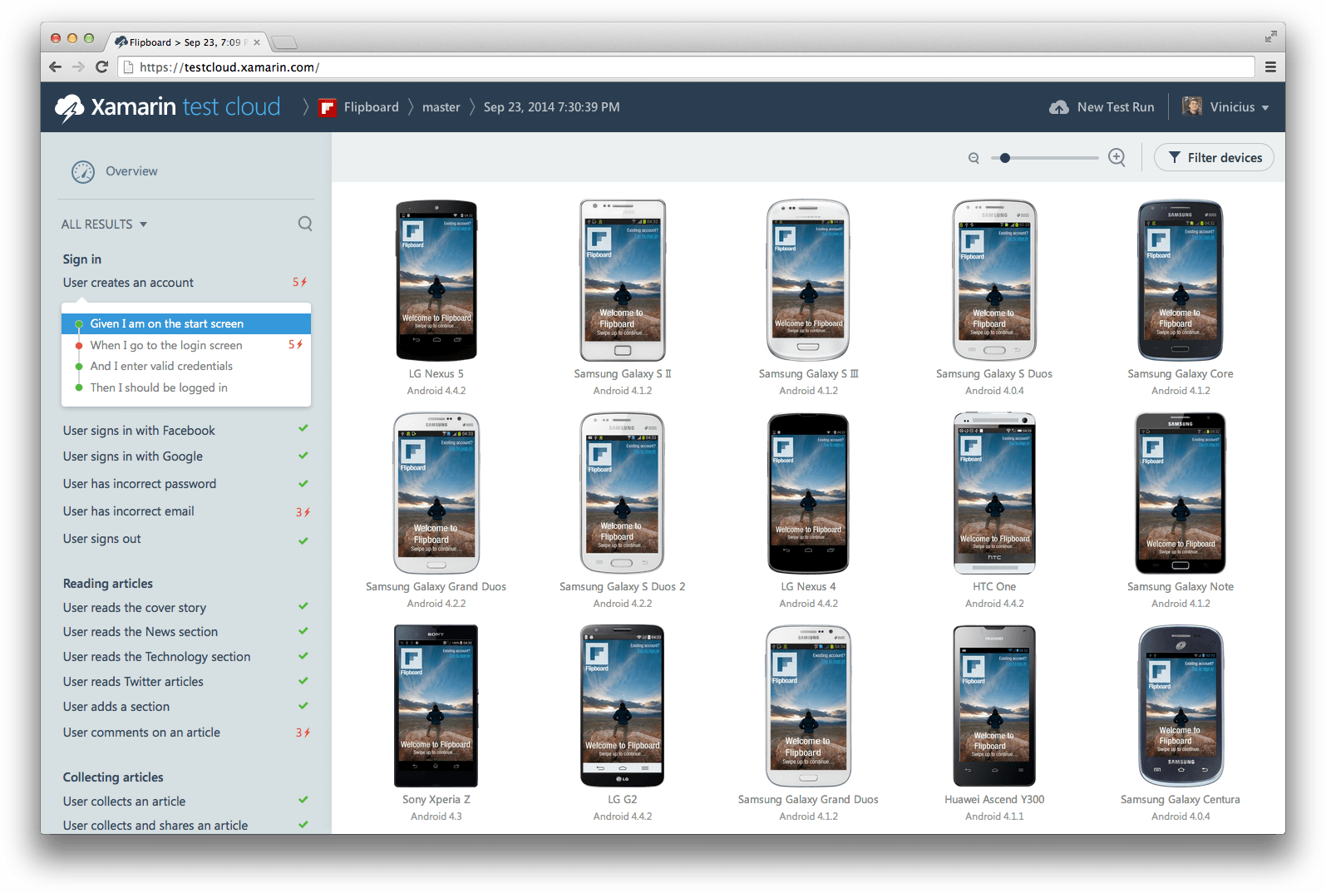
Xamarin Test Cloud: Testing on Real Devices

Slide 16



Continuously Product Improvements
Distribute app to beta users
Monitor your app’s health
Understand your users
Measure adoption and usage
Quickly resolve app crashes
Continuous Integration & Delivery

Slide 17
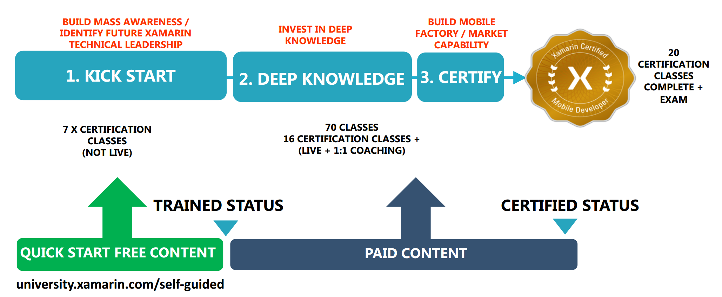
Xamarin University

Slide 18
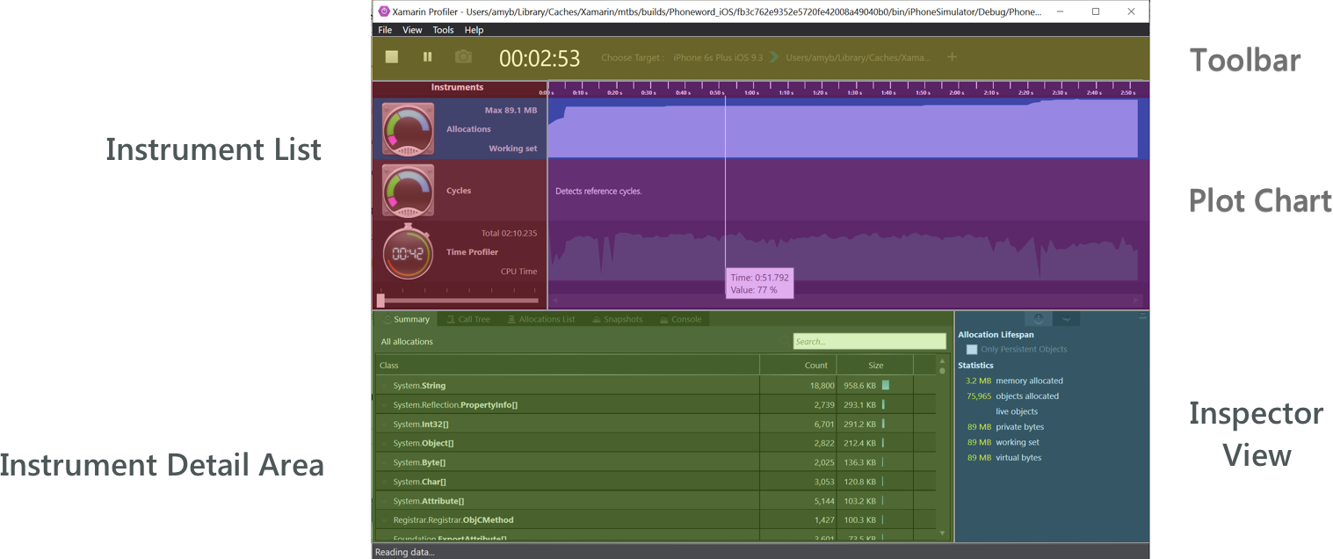
Xamarin Profiler
https://developer.xamarin.com/guides/cross-platform/profiler/

Slide 19
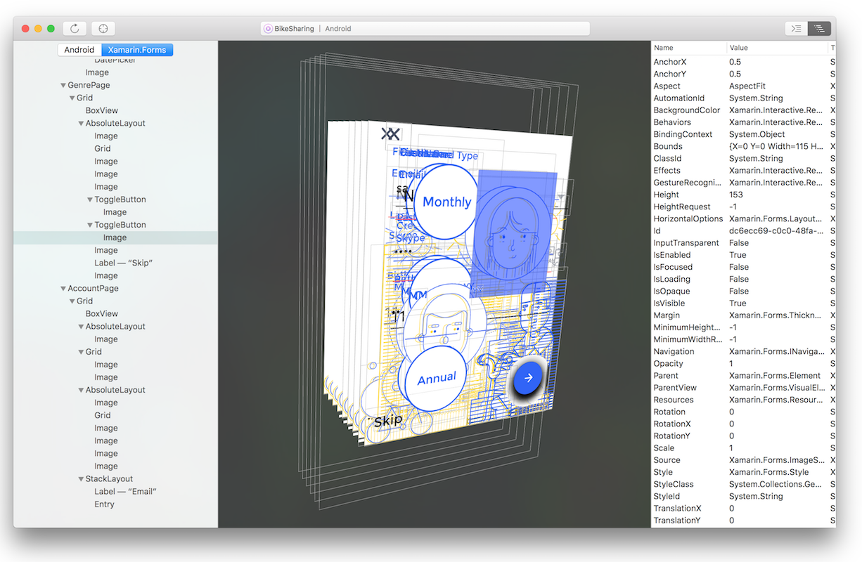
Xamarin Inspector
The Inspector integrates with the app debugging workflow of your IDE, serving as a debugging or diagnostics aid when inspecting your running app.
https://developer.xamarin.com/guides/cross-platform/inspector/

Slide 20
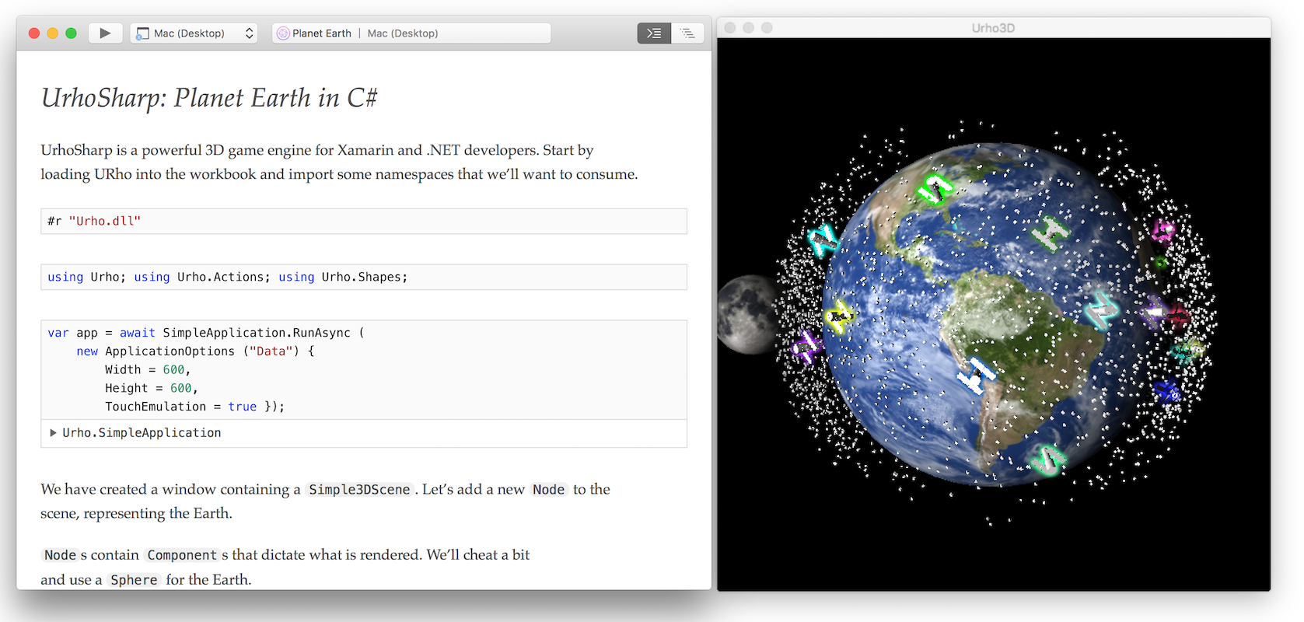
Xamarin Workbooks
A blend of documentation and code that is perfect for experimentation, learning, and creating guides and teaching aids.
https://developer.xamarin.com/guides/cross-platform/workbooks/

Slide 21
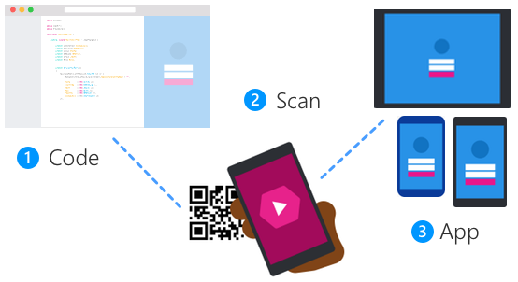
Xamarin Live Player
Test app code changes in real time on your iOS or Android device
Create or open a Xamarin app.
Debug or run, and then scan to pair your device.
The app runs right on your phone or tablet.
https://developer.xamarin.com/guides/cross-platform/live/

Slide 22
Drawbacks
Price. It’s not cheap.
Minor bugs & updates issues.
Applications binaries size is bigger.
Mac machine is required.
Harder to find Xamarin developers.
Xamarin.Forms are not suitable for all project types.
Not the best choice for rich UI apps with poor business logic.
Small community comparing to iOS/Android/.NET but it’s growing.
Suitable only for new apps.
Customers are afraid of cross-platform tools.

Slide 23
Xamarin.Forms 3.0
Xamarin.Forms Embedding Take any ContentPage in XAML or C# and embed it directly into a Xamarin.iOS, Xamarin.Android, or UWP application.
Reach More Platforms macOS, Linux, WPF
Speed Boosts and Enhancements
Introducing XAML Standard
https://blog.xamarin.com/glimpse-future-xamarin-forms-3-0/

Slide 24
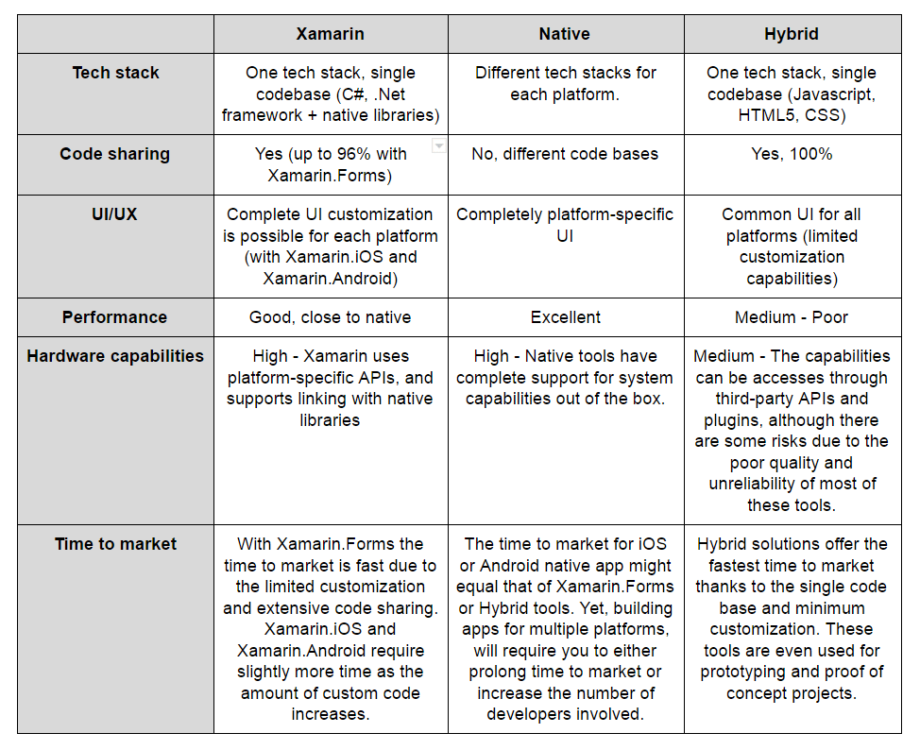
Xamarin vs Native iOS/Android vs Hybrid

Slide 25
Xamarin Ukraine Telegram Chat
https://t.me/xamarin_ukraine

Slide 26
Q&A
Alex.Krakovetskiy@devrain.com
@sashaeve

